Slide 1


Mahmoud ALI
20-04-2022

Slide 2

Outline
Executive Summary
Introduction
Methodology
Results
Conclusion
Appendix

Slide 3
Executive Summary
Summary of methodologies
Data Collection using API and Web Scraping
Exploratory Data Analysis using SQL
Exploratory Data Analysis using Data Visualization
Interactive Visual Analytics with Folium
Interactive Visual Analytics with Dashboard
Machine Learning Prediction
Summary of all results
Exploratory Data Analysis
Interactive analytics in Dashboard
Predictive Analytics using different algorithms

Slide 4
Introduction
Project background and context
Space X advertises Falcon 9 rocket launches on its website with a cost of 62 million dollars; other providers cost upward of 165 million dollars each, much of the savings is because Space X can reuse the first stage. Therefore, if we can determine if the first stage will land, we can determine the cost of a launch. The goal of the project is to create a machine learning pipeline to predict if the first stage will land successfully.
Problems you want to find answers
The factors affect the successful landing of the rocket
The interaction of various features that determine the success rate of a successful landing.
The operating conditions assist the successful landing

Slide 5

Section 1

Slide 6
Methodology
Executive Summary
Data collection methodology:
Data was collected using SpaceX API and web scraping from Wikipedia
Perform data wrangling
Clean data to be suitable for exploratory data analysis and machine learning.
Perform exploratory data analysis (EDA) using visualization and SQL
Perform interactive visual analytics using Folium and Plotly Dash
Perform predictive analysis using classification models
How to build, tune, evaluate classification models

Slide 7
Data Collection
The data was collected using various methods
Data was collected using get request to the SpaceX API.
using .json() and .json_normalize(), the response content is turned to a pandas dataframe.
The missing values are examined and replace with the appropriate values
A web scraping from Wikipedia for Falcon 9 launch records is performed with BeautifulSoup.
Using the BeautifulSoup, the HTML tables are parsed and converted to pandas dataframe.

Slide 8
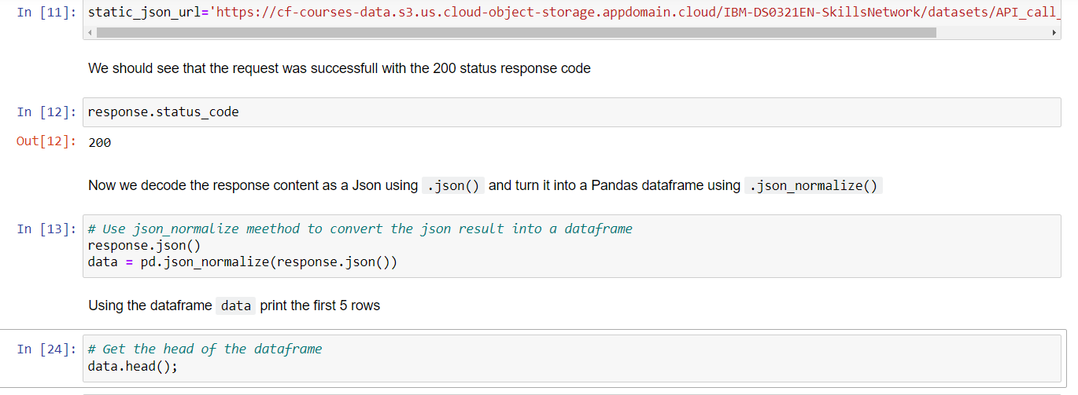
Data Collection – SpaceX API
get request to the SpaceX API is used to collect data, clean the requested data and did some data wrangling and formatting
https://github.com/mahmoud-E-ALI/Capstone-IBM-Coursera/blob/main/jupyter-labs-spacex-data-collection-api.ipynb

Slide 9
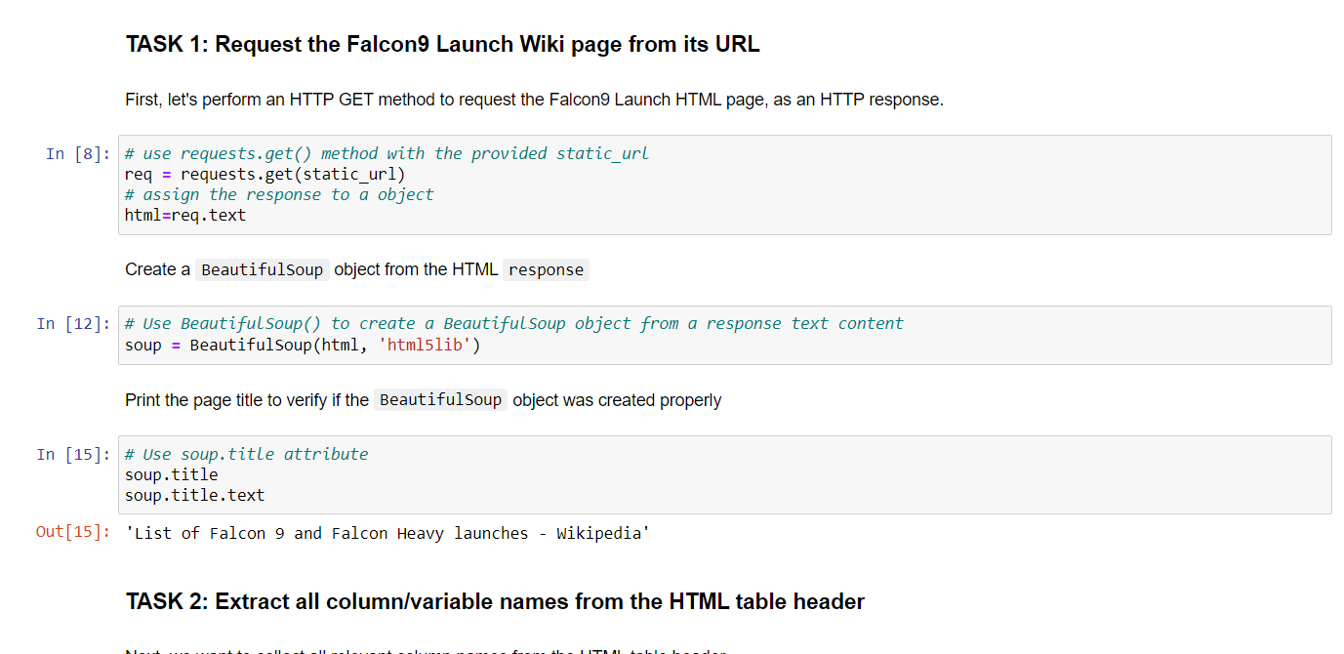
Data Collection - Scraping
A web scraping from Wikipedia for Falcon 9 launch records is performed with BeautifulSoup.
Using the BeautifulSoup, the HTML tables are parsed and converted to pandas dataframe.
https://github.com/mahmoud-E-ALI/Capstone-IBM-Coursera/blob/main/jupyter-labs-webscraping.ipynb
Place your flowchart of web scraping here

Slide 10
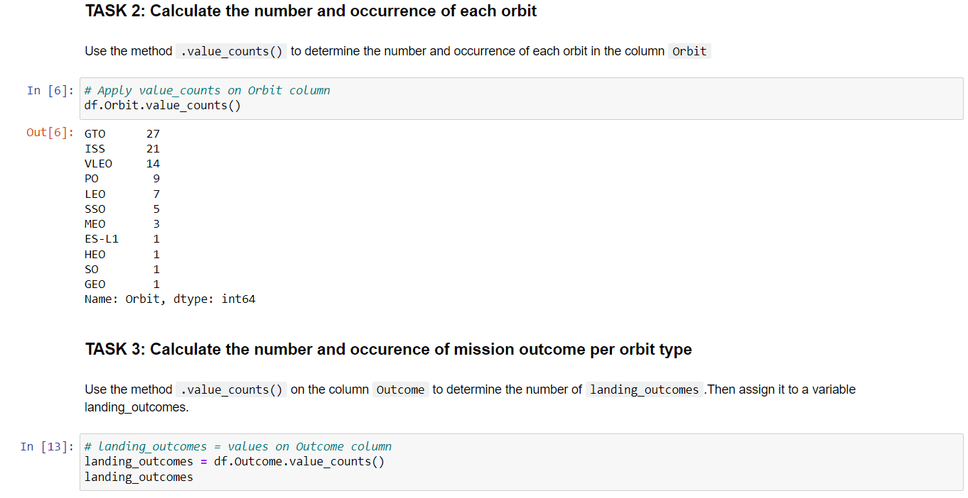
Data Wrangling
The data is cleaned and duplication and missing values are examined
Missing values are replaced with the appropriate values
https://github.com/mahmoud-E-ALI/Capstone-IBM-Coursera/blob/main/labs-jupyter-spacex-Data%20wrangling.ipynb

Slide 11
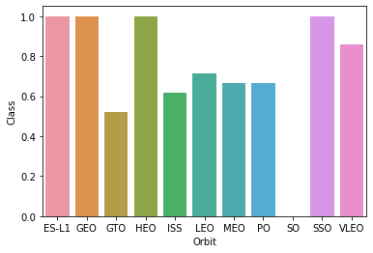
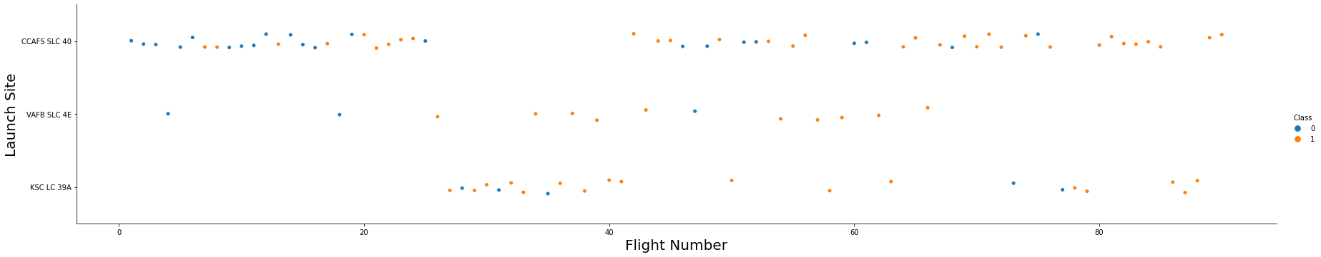
EDA with Data Visualization
The data is explored by visualizing the relationship between flight number and launch Site, payload and launch site, success rate of each orbit type, flight number and orbit type, the launch success yearly
https://github.com/mahmoud-E-ALI/Capstone-IBM-Coursera/blob/main/jupyter-labs-eda-dataviz.ipynb

Slide 12
EDA with SQL
The SpaceX dataset is used with MYSQL database
Different queries are examined using SQL magic function in Jupyter.
The queries include:
The names of unique launch sites in the space mission.
The total payload mass carried by boosters launched by NASA (CRS)
The average payload mass carried by booster version F9 v1.1
The total number of successful and failure mission outcomes
The failed landing outcomes in drone ship, their booster version and launch site names.
https://github.com/mahmoud-E-ALI/Capstone-IBM-Coursera/blob/main/jupyter-labs-eda-sql-coursera.ipynb

Slide 13
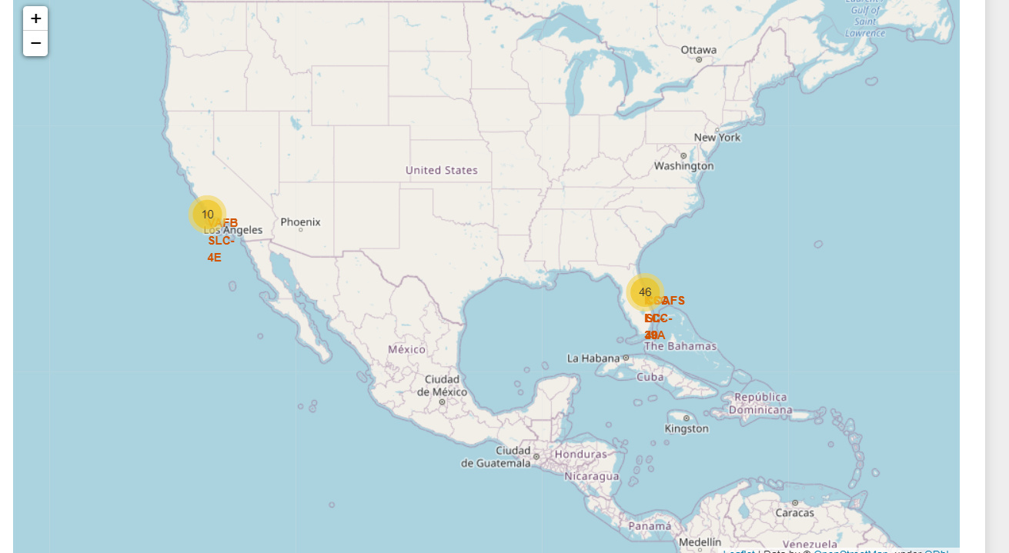
Build an Interactive Map with Folium
All launch sites are explained on map with adding objects such as markers, circles, lines to mark the success or failure of launches for each site.
An assignment of failure or success on each site is differentiate by color .
The distances between a launch site to its proximities to railway, high way and coasts are explained.
https://github.com/mahmoud-E-ALI/Capstone-IBM-Coursera/blob/main/lab_jupyter_launch_site_location.ipynb

Slide 14
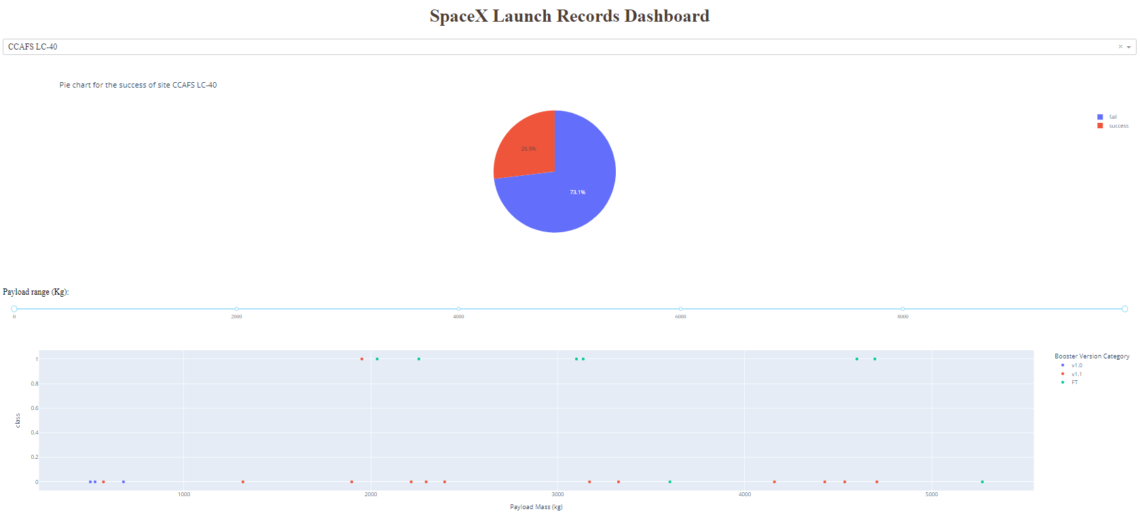
Build a Dashboard with Plotly Dash
a Plotly Dash application for users to perform interactive visual analytics on SpaceX launch data in real-time.
This dashboard application contains input components such as a dropdown list and a range slider to interact with a pie chart and a scatter point chart.
https://github.com/mahmoud-E-ALI/Capstone-IBM-Coursera/blob/main/spacex_dash_app.py

Slide 15
Predictive Analysis (Classification)
The predictive analysis is started by importing the required packages
Indicating the input data and the output data
Splitting the data into train and test data
Try multiple algorithm to get the best results for the prediction
These algorithms are :
Logistic Regression classification algorithm
Support Vector Machine classification algorithm
Decision Tree classification algorithm
K Nearest Neighbors classification algorithm
https://github.com/mahmoud-E-ALI/Capstone-IBM-Coursera/blob/main/SpaceX_Machine%20Learning%20Prediction_Part_5.ipynb

Slide 16
Results
Exploratory data analysis results
Interactive analytics demo in screenshots
Predictive analysis results

Slide 17

Section 2

Slide 18
Flight Number vs. Launch Site
This Figure shows that as the flight number increases, the success rate increases at all launch sites.

Slide 19
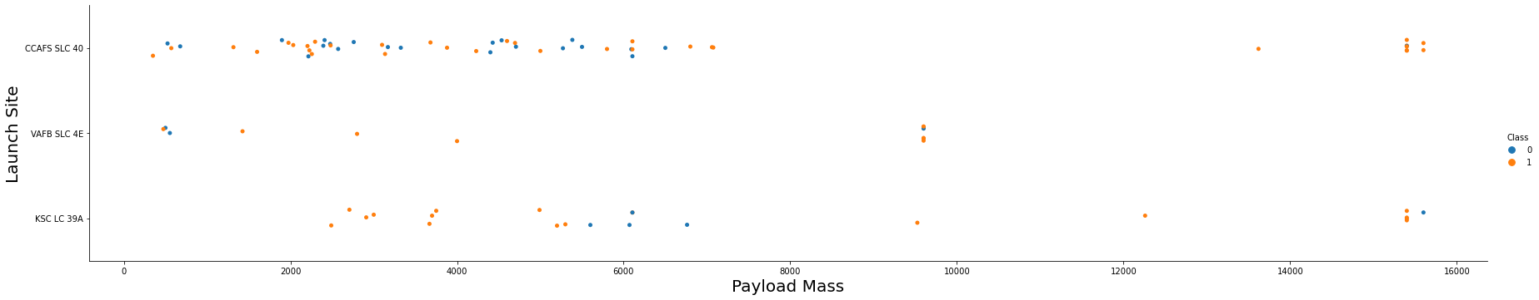
Payload vs. Launch Site
Now if you observe Payload Vs. Launch Site scatter point chart you will find for the VAFB-SLC launchsite there are no rockets launched for heavypayload mass(greater than 10000)

Slide 20
Success Rate vs. Orbit Type
This Figure shows a bar chart for the success rate of each orbit type, in which the high success rate at ES-L1, GEO, HEO and SSO

Slide 21
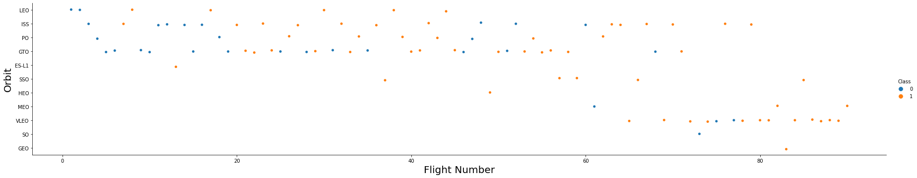
Flight Number vs. Orbit Type
It is shown that in the LEO orbit the Success appears related to the number of flights; on the other hand, there seems to be no relationship between flight number when in GTO orbit

Slide 22
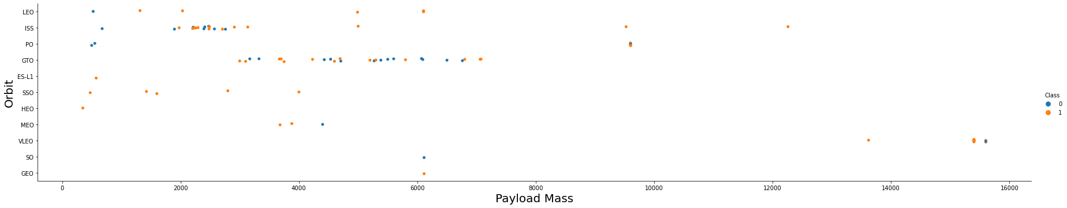
Payload vs. Orbit Type
With heavy payloads the successful landing or positive landing rate are more for Polar,LEO and ISS.
However for GTO we cannot distinguish this well as both positive landing rate and negative landing(unsuccessful mission) are both there here.

Slide 23
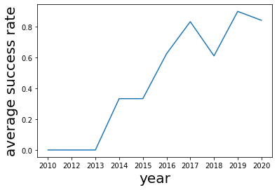
Launch Success Yearly Trend
you can observe that the sucess rate since 2013 kept increasing till 2020

Slide 24
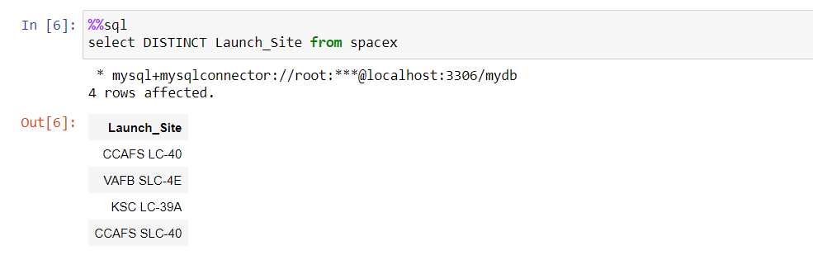
All Launch Site Names
The querry is used as shown with the DISTINCT keyword

Slide 25
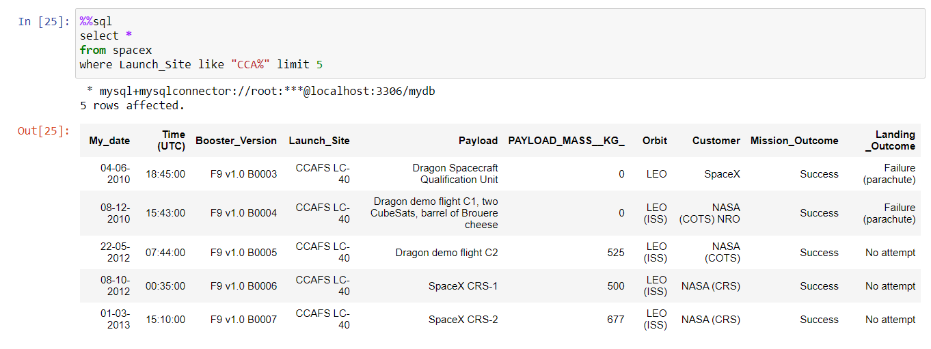
Launch Site Names Begin with 'CCA'
Find 5 records where launch sites begin with `CCA`

Slide 26
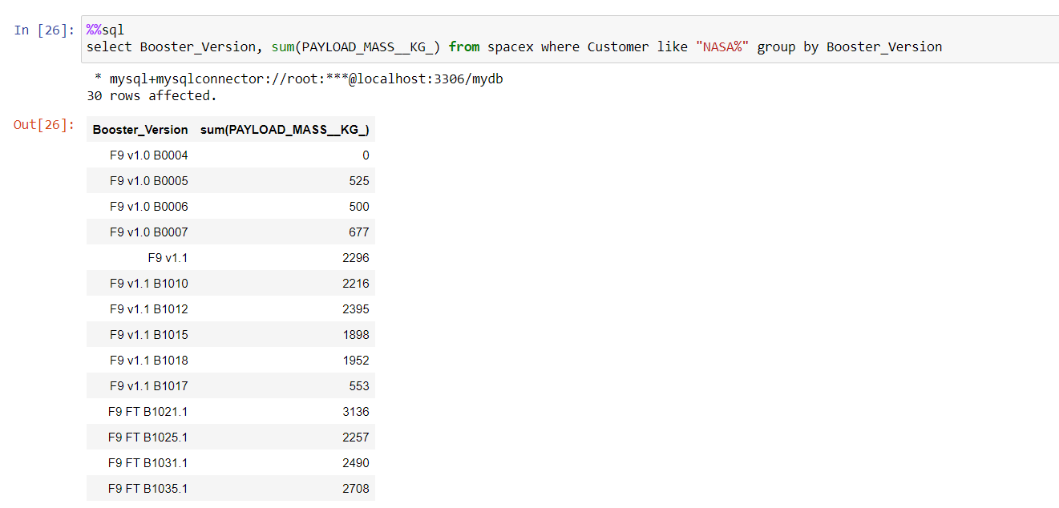
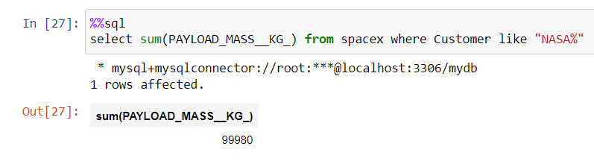
Total Payload Mass
Calculate the total payload carried by boosters from NASA

Slide 27
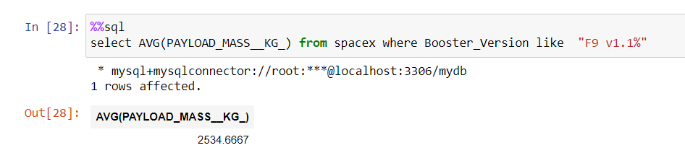
Average Payload Mass by F9 v1.1
Calculate the average payload mass carried by booster version F9 v1.1

Slide 28
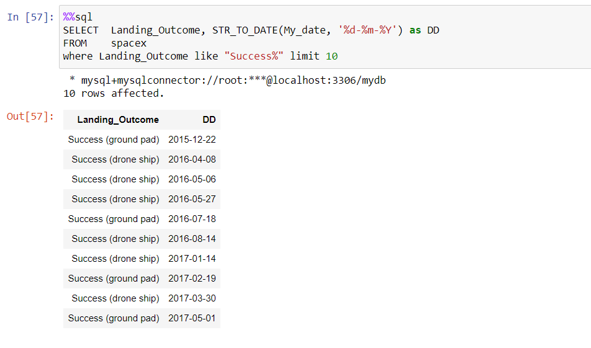
First Successful Ground Landing Date
Find the dates of the first successful landing outcome on ground pad

Slide 29
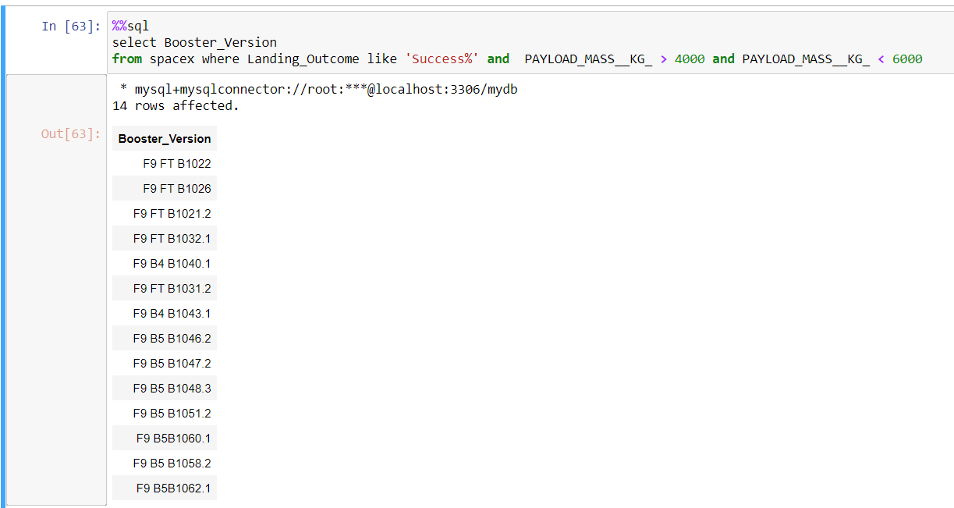
Successful Drone Ship Landing with Payload between 4000 and 6000
List the names of boosters which have successfully landed on drone ship and had payload mass greater than 4000 but less than 6000

Slide 30
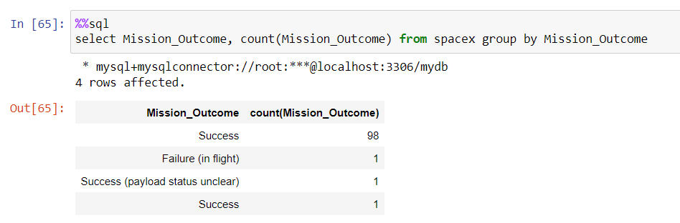
Total Number of Successful and Failure Mission Outcomes
Calculate the total number of successful and failure mission outcomes

Slide 31
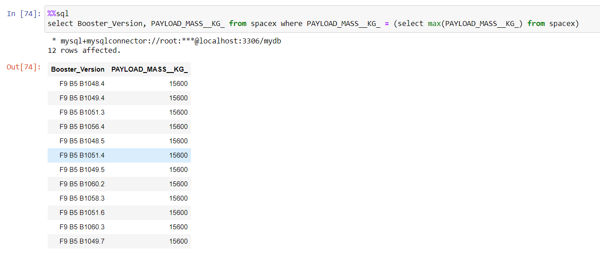
Boosters Carried Maximum Payload
List the names of the booster which have carried the maximum payload mass

Slide 32
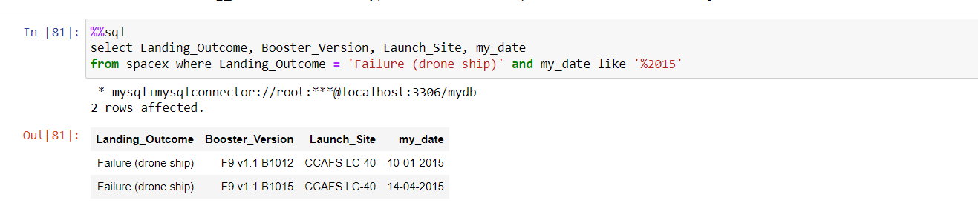
2015 Launch Records
List the failed landing_outcomes in drone ship, their booster versions, and launch site names for in year 2015

Slide 33
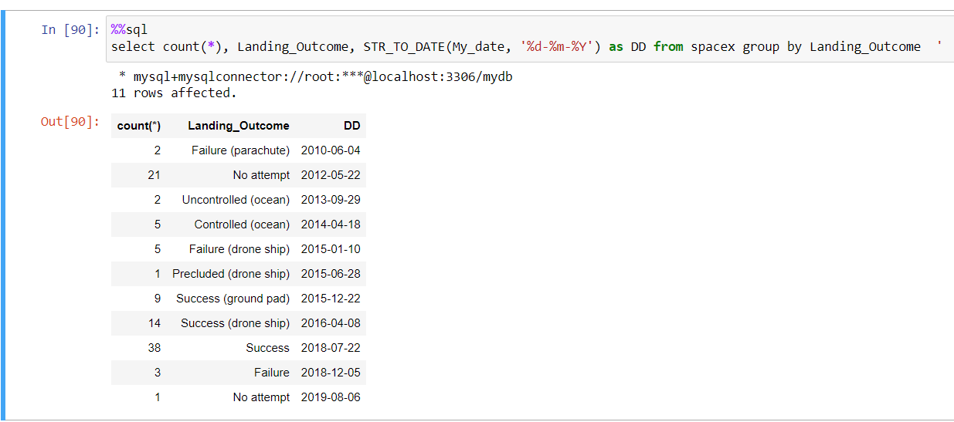
Rank Landing Outcomes Between 2010-06-04 and 2017-03-20
Rank the count of landing outcomes (such as Failure (drone ship) or Success (ground pad)) between the date 2010-06-04 and 2017-03-20, in descending order
Present your query result with a short explanation here

Slide 34

Section 3

Slide 35
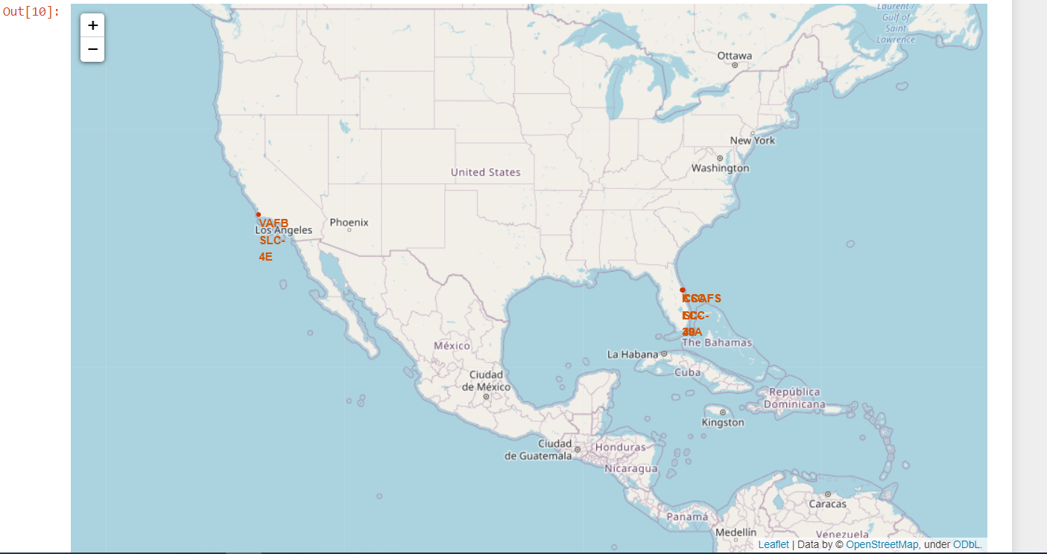
all launch sites on a map

Slide 36
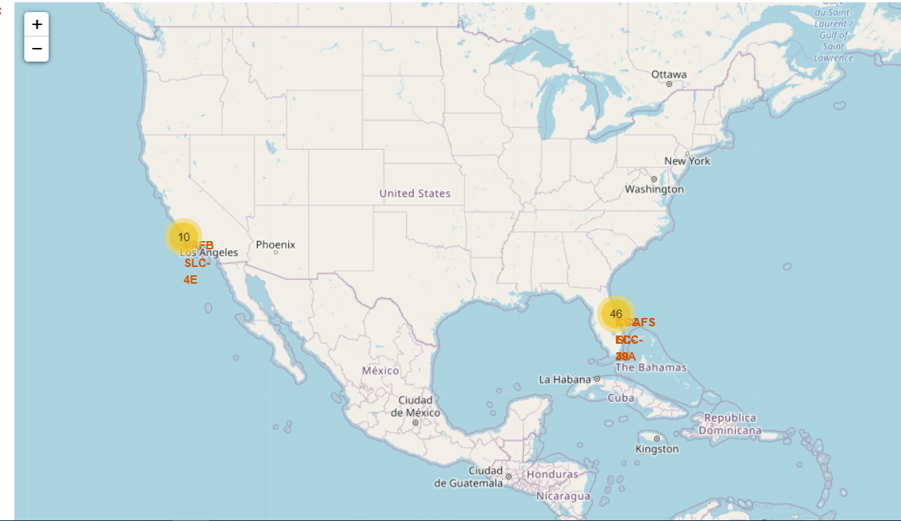
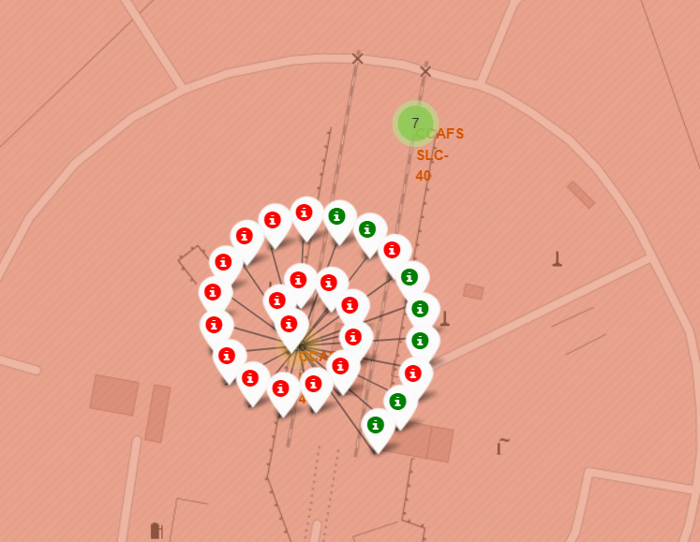
The success/failed launches for each site on the map

Slide 37
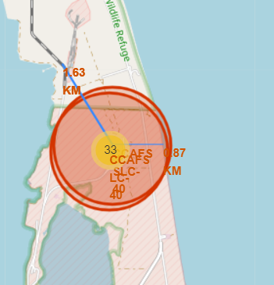
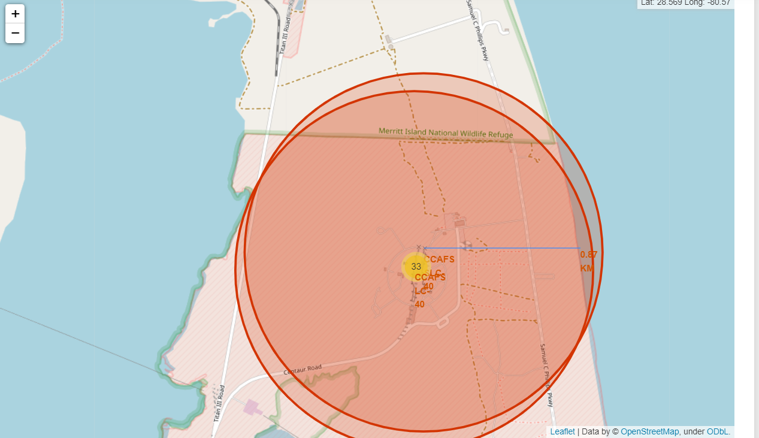
the distances between a launch site to its proximities

Slide 38

Section 4

Slide 39
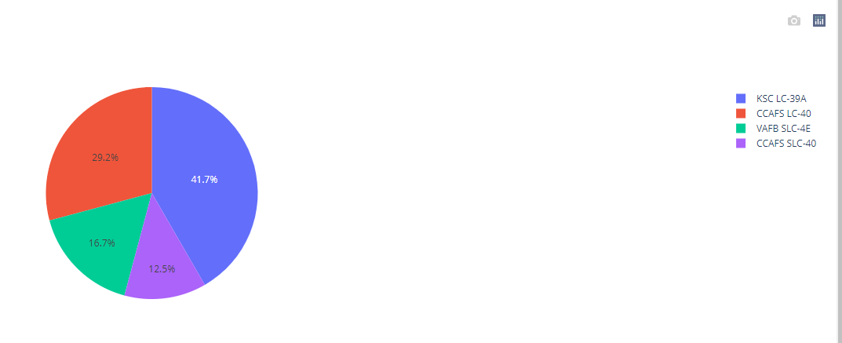
Pie chart showing the success rate of all launch site
The launch site KSC LC-39A has the largest success rate over all sites

Slide 40
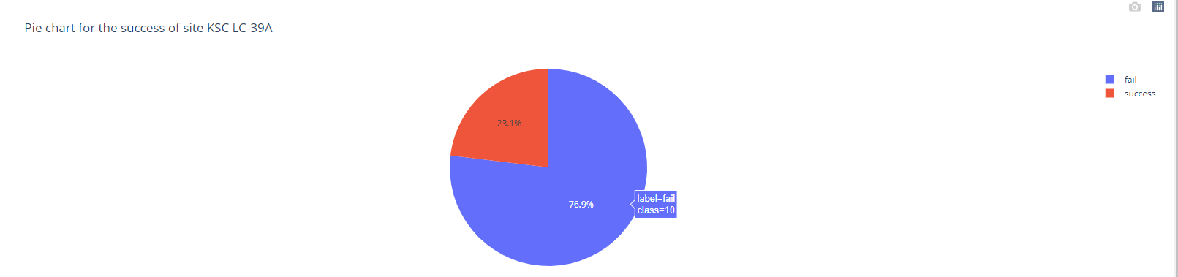
Pie chart showing the Launch site with the highest launch success ratio
The largest success is at launch site KSC LC-39A, where 23.1% has success over are tries

Slide 41
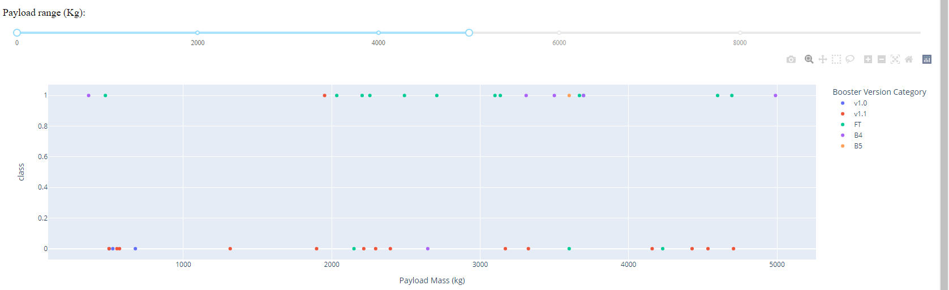
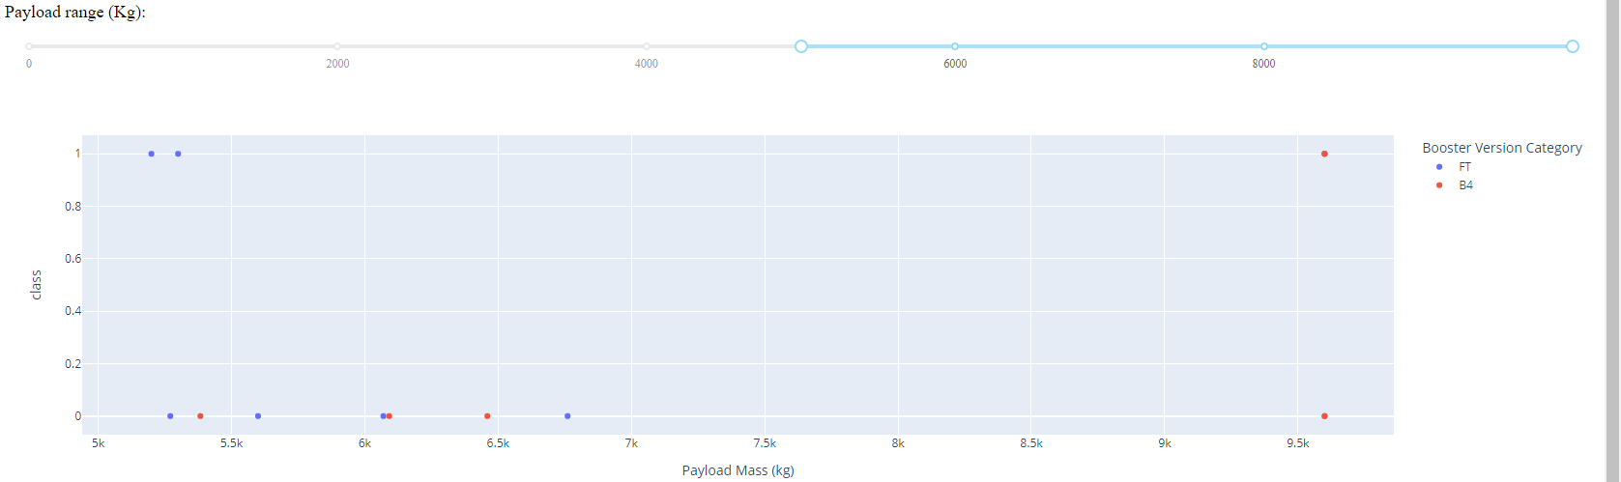
Payload vs. Launch Outcome scatter plot for all sites with different payload
Payload from 0- 5000 kg
Payload from 5000- 10000 kg

Slide 42

Section 5

Slide 43
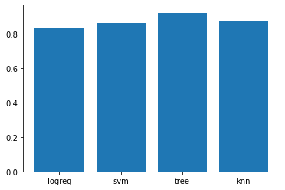
Classification Accuracy
The accuracy of models as follows:
'logreg': 0.84,
'svm': 0.86,
'tree': 0.92,
'knn': 0.88
It can be shown that the Decision tree has the best accuracy

Slide 44
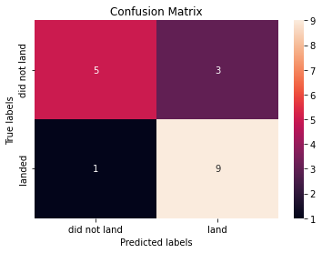
Confusion Matrix
the Decision tree has the best accuracy

Slide 45
Conclusions
Launch success rate started to increase in 2013 till 2020.
Orbits ES-L1, GEO, HEO and SSO have the most success rate.
KSC LC-39A had the most successful launches of any sites.
The Decision tree classifier is the best machine learning algorithm for this task.

Slide 46


